Slide 1

The Authority of Jesus
Expect the Unexpected
Matthew 8:1-17
Power & Authority of the King

Slide 2

Matthew 8-9 Power & Authority of the King
Who is this Jesus we are to follow?
Jesus Our Healer - His Power to Heal (8:1-17)
His Authority over Nature and Demons (8:18-34)
His Heart of Mission to the Lost (9: 1-17)
His Trustworthiness (9:18-34)
His Compassion for the Lost - Join His Mission! (9:35-38)

Slide 3

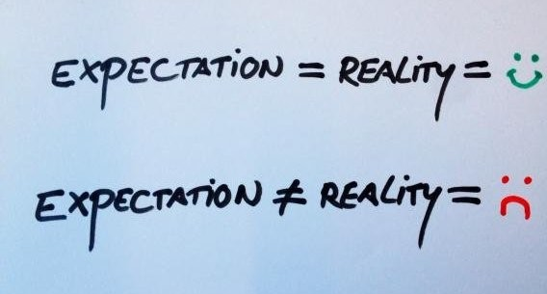
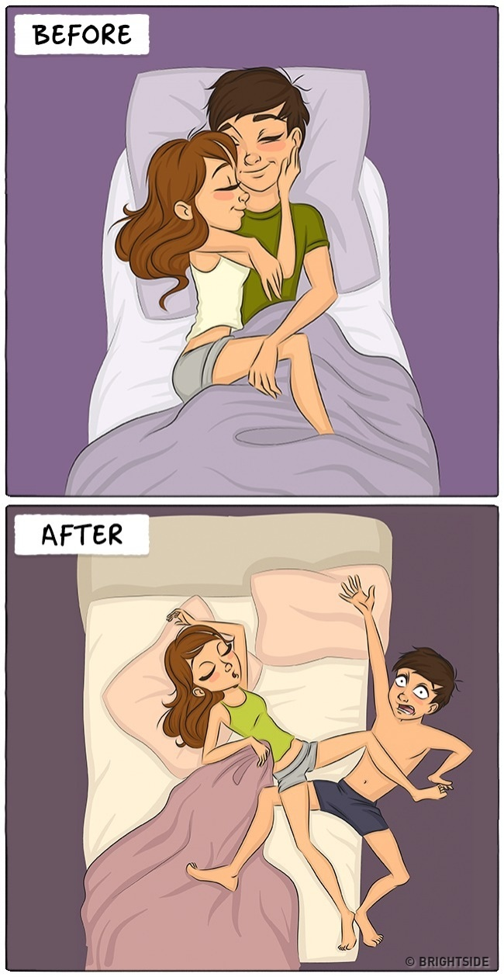
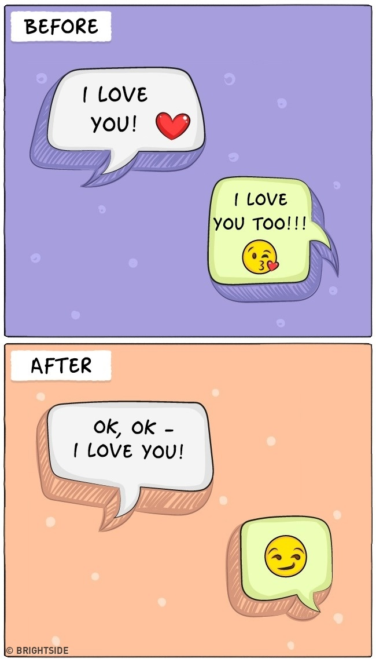

Expectation,
Reality, and Disappointment
What are our expectations when we take up the challenge to live the kingdom life as his disciples?
Amazement!
Reality Beyond Expectation

Slide 4
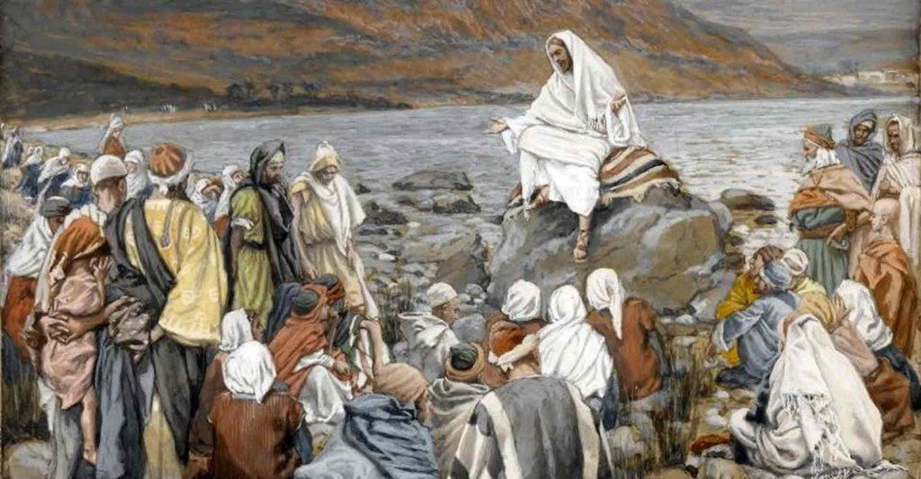
The Authority of Jesus
Matthew 8:18-34
When Jesus saw the crowd around him, he gave orders to cross to the other side of the lake.
Their Expectations?
Cost of Following Jesus?

Slide 5
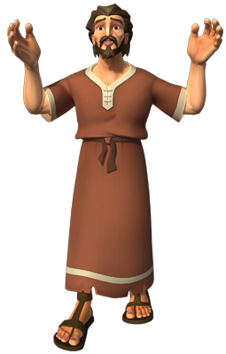
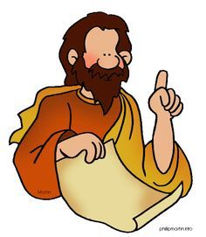
Two people came to him with Two expectations
¹⁹ Then a teacher of the law came to him and said, ‘Teacher, I will follow you wherever you go.’
²¹ Another disciple said to him, ‘Lord, first let me go and bury my father.’
An overconfident teacher
and a reluctant disciple

Slide 6

2 Unexpected Responses
To the overconfident teacher
‘Foxes have dens and birds have nests, but the Son of Man has nowhere to lay his head.’
Great Cost!
Jesus
Hardship & Homeless

Slide 7
To the reluctant disciple
‘Follow me, and let the
dead bury their own dead.’
Urgency and Commitment NOW!
Set Your Priority Right!
Jesus

Slide 8
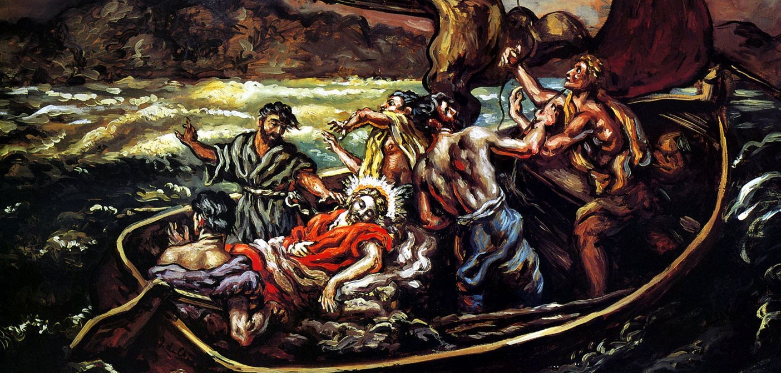
The Unexpected Fierce Storm
²³ Then he got into the boat and his disciples followed him. ²⁴ Suddenly a furious storm came up on the lake, so that the waves swept over the boat. But Jesus was sleeping. ²⁵ The disciples went and woke him, saying, ‘Lord, save us! We’re going to drown!’
The Unexpected Master
Sleeping!

Slide 9
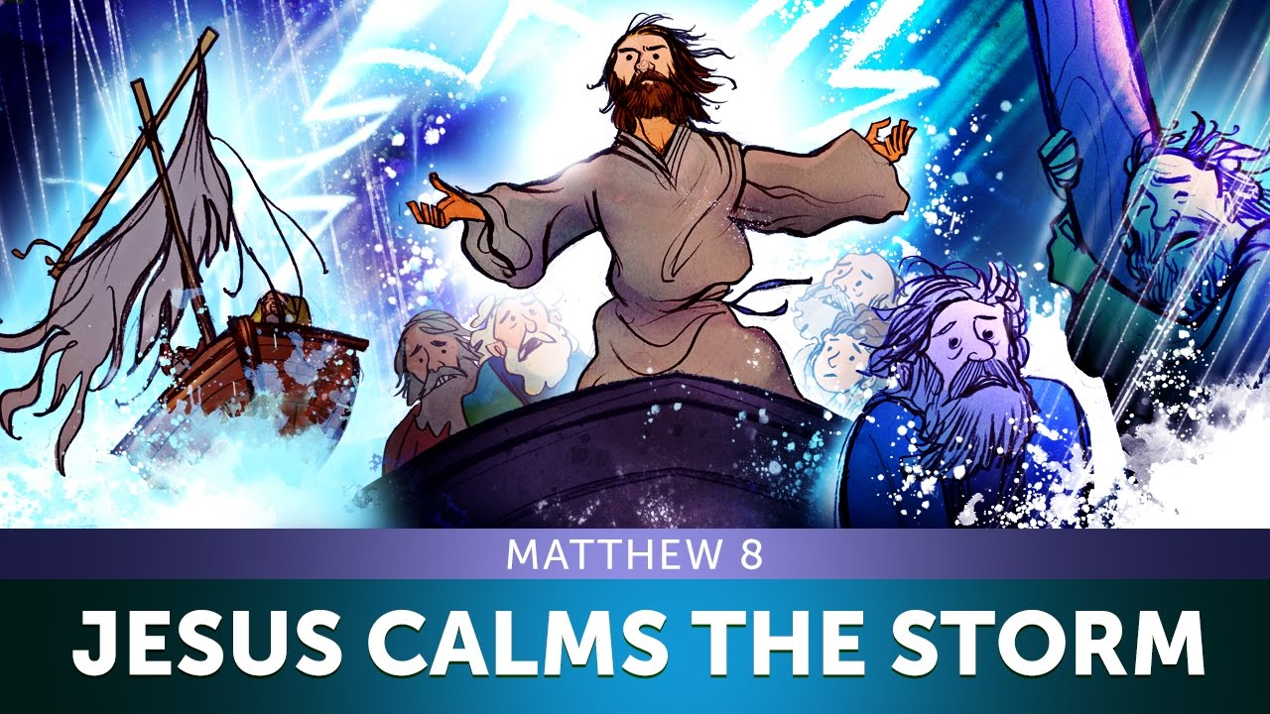
Jesus rebuked the disciples and calmed the waves
²⁶ He replied, ‘You of little faith, why are you so afraid?’ Then he got up and rebuked the winds and the waves, and it was completely calm.
Their fear of the wave drove out their faith
They failed to recognize who Jesus really is

Slide 10
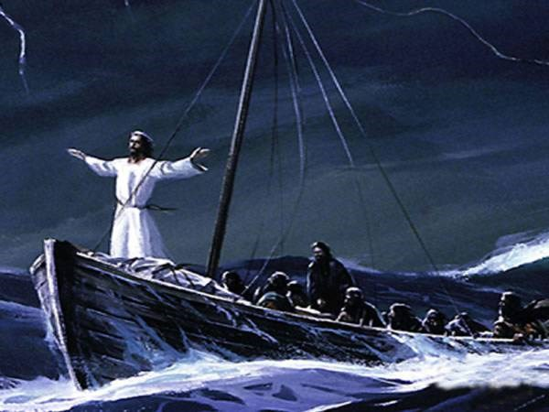
The disciples were pleasantly amazed at the unexpected power encounter
²⁷ The men were amazed and asked, ‘What kind of man is this? Even the winds and the waves obey him!’
Jesus’ mastery over nature
They came to Know who Jesus is!
The Creator of Heaven and Universe

Slide 11
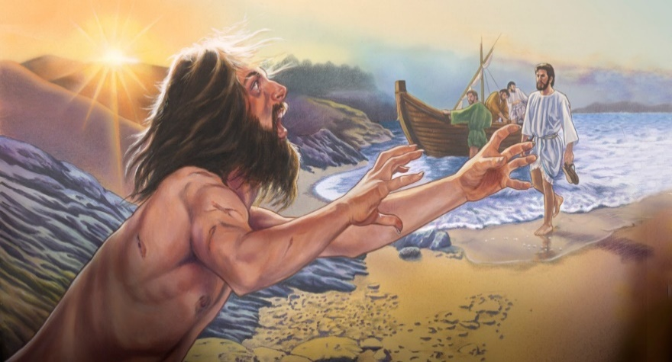
Another Unexpected Encounter
²⁸ When he arrived at the other side in the region of the Gadarenes, two demon-possessed men coming from the tombs met him. They were so violent that no one could pass that way.
²⁹ ‘What do you want with us, Son of God?’ they shouted. ‘Have you come here to torture us before the appointed time?’
Even the demons knew Jesus and their ultimate fate

Slide 12
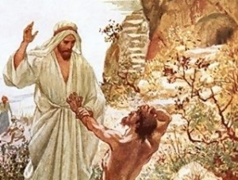
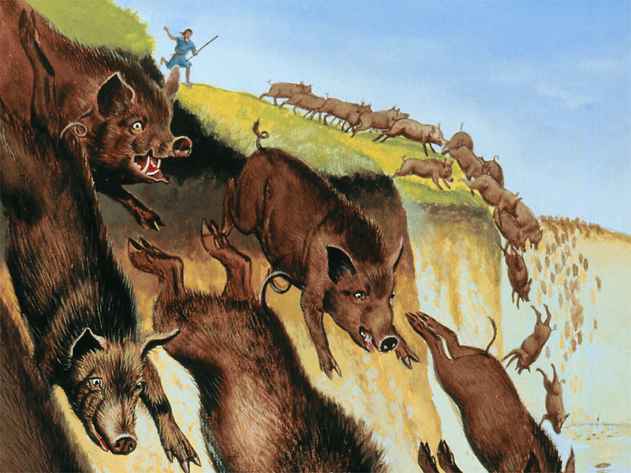
Jesus restored the men with an unexpected method
³⁰ Some distance from them a large herd of pigs was feeding. ³¹ The demons begged Jesus, ‘If you drive us out, send us into the herd of pigs.’ ³² He said to them, ‘Go!’ So they came out and went into the pigs, and the whole herd rushed down the steep bank into the lake and died in the water.
Jesus valued the men more than the pigs!

Slide 13
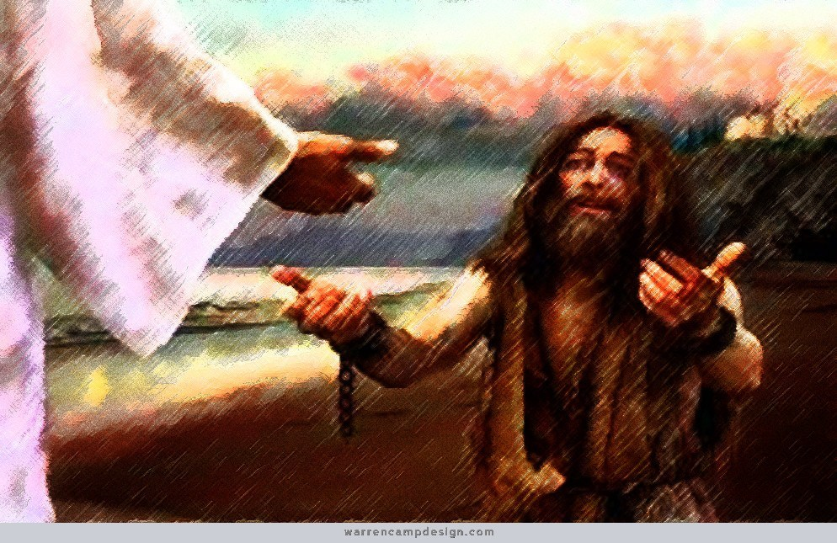
The unexpected struck fear into their heart
³³ Those tending the pigs ran off, went into the town and reported all this, including what had happened to the demon-possessed men. ³⁴ Then the whole town went out to meet Jesus. And when they saw him, they pleaded with him to leave their region.
Fear Instead of Trust!
They loved the pigs more than Jesus and the men

Slide 14
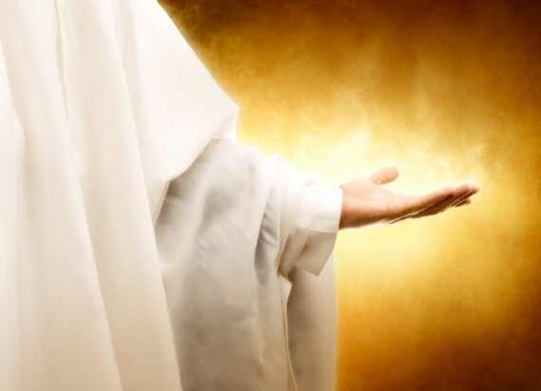

The Authority of Jesus
When we follow Jesus
Know the Cost and Urgency
Costly Grace!

Slide 15

Expect the Unexpected !
Do not fear
Know Jesus Have faith in Jesus
With Jesus Through the Storm of Life
Facing strong enemies
Don’t waver, keep your eyes on Jesus!
Be Amazed!

Slide 16
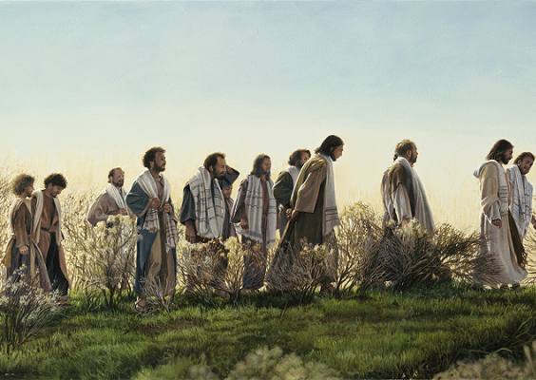
Joyful Reverence Journey of Discipleship
Astonished
and Afraid
Mark 10:32
They were on their way up to Jerusalem, with Jesus leading the way, and the disciples were astonished, while those who followed were afraid.

Slide 17
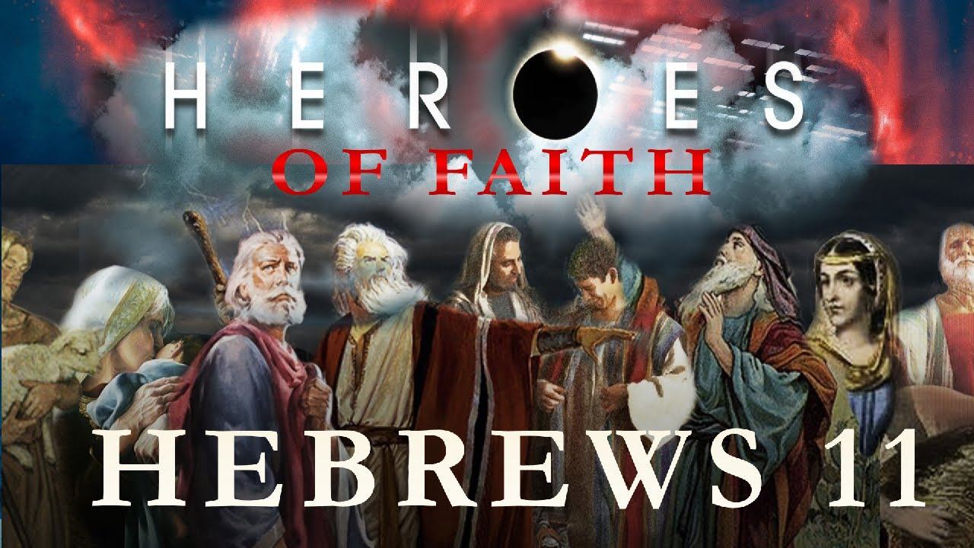
The Cloud of Witnesses who Compass us About
Hebrews 11:33-34
³³ who through faith conquered kingdoms, administered justice, and gained what was promised; who shut the mouths of lions,
³⁴ quenched the fury of the flames, and escaped the edge of the sword; whose weakness was turned to strength; and who became powerful in battle and routed foreign armies.
Heroes

Slide 18

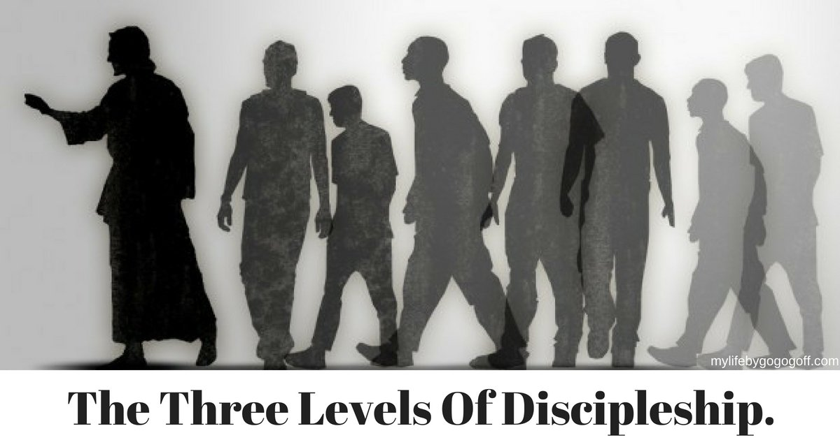
Be His Kingdom Disciples
Seek Him, Know Him,
Follow Him Reverently.
Be pleasantly surprised by him!
His amazing grace, love, faithfulness, power

